Slide 1
SHOULD COPYRIGHT LEGISLATE AGAIMST NEGLICENCE?
SHOULD WE INTRODUCE REVERSIONARY INTERESTS?
ALAI Conference 2025, Opatija

Slide 2
Problem With Large Catalogue Licensing and Accurate Accounting
THE PROBLEM – US$424.3 million (“Black Box”)
Unaccounted or Royalties NOT Being Paid to Rightful Owners of Works
ONE POSSIBLE SOURCE IN ASIA – THE ORIGINAL SIN
Inaccurate data from record companies (Producer and User of copyright protected works)
Current Legal/Legislative Discourse in Asia – Horizontal and not Vertical

Slide 3
Licensing, Reporting & Accounting
DSP LICENSED – NO INFRINGEMENT
* 4 licences
Sound recordings – mechanical and making available to the public
Musical and literary works – mechanical and communication to the public
REPORTING ON USE AND MATCHING

Slide 4
Reporting and Accounting
Importance of Matching
Chain of Reliance/Flow of Information
1. Why CMOs and music publishers R on DSP’s Report v Broadcasting
private/individual use
Interactive
Why DSP reliant on record companies

Slide 5
The Original Sin
Clearance for Mechanical Rights for Production of Records
Original Data on Use
Labels Information Telling

Slide 6
Ideal Information for Musical and Literary Works Used
INFORMATION
Song Title and Names of Authors (composer and lyricist)
© Year of First Publication
Original Publisher
Sub-Publisher
PURPOSE
Subsistence
Infringement proceedings – presumptions and causative link (timing)

Slide 7
The Original Sin?
Label Information Published Suggest Lack of Care in Clearance and Data Maintenance
Example of “Sing Sing So”
The Composer is Siddik Sitompul

Slide 8
SING SING SO, by Siddik Sitompul (aka S.Dis Sitompul)

Slide 9
Wrong Authors
For Teresa Teng
Indonesian Folksong (Folksongs have authors, too)
Mandarin Lyrics – Lyricist not acknowledged (outright assignment)
For Viky Sianipar
Batak. He is born in 1976. Too young to have written the song.
Suharto named street after Siddik Sitompul in 1971

Slide 10
Reason for Choice of ”Sing Sing So” and Covers by Teresa Teng and Viky Sianipar
Famous Song and Composer (1971 – street named after Siddik Sitompul. 2022 – Monumen Sing Sing So. Staple in Chinese-Indonesia Exchange)
Famous Singers
Teresa Teng (48 million) (Spotify – 704.4 k listeners monthly)
Viky Sianipar (Spotify – 175.8 listeners monthly).
Countries –
Hong Kong (entertainment centre – worldwide sales)
Indonesia (most populous muslim country – sales figures)
Regional Politics
Languages (Cover in a different language)
Importance of International Conventions in Protection of Works
Duration – 40 years (1980s to 2025)

Slide 11
Legal Recourse (Concentrate on Economic Rights)
Copyright Infringement Against DSP and/or Record Companies?
Negligence?
Statutory Limitation

Slide 12
If Time Barred
Difference Between Copyright Infringement and Negligence Especially for Streaming
Infringement – NEW ACTION EACH TIME THE WORK IS STREAMED
Negligence – Dependent on When Clearance took place - frozen in time (Streaming became popular in mid-2010s)
Spotify penetrated Hong Kong in 2013 and Indonesia in 2016 (to be verified)

Slide 13
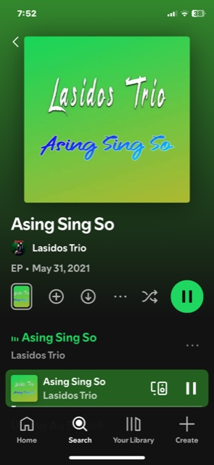
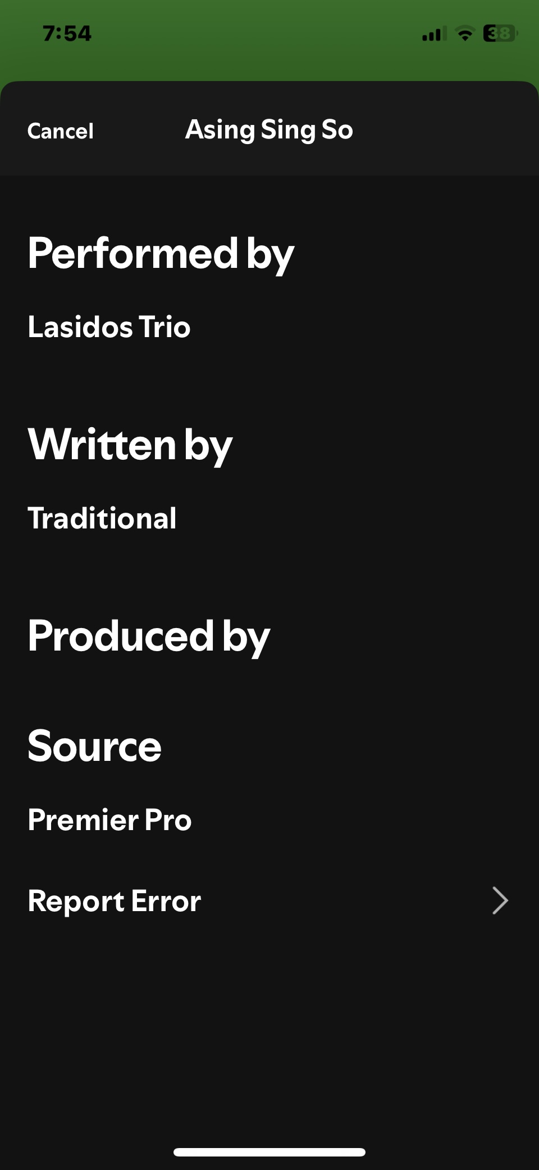
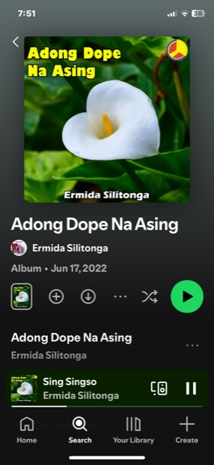
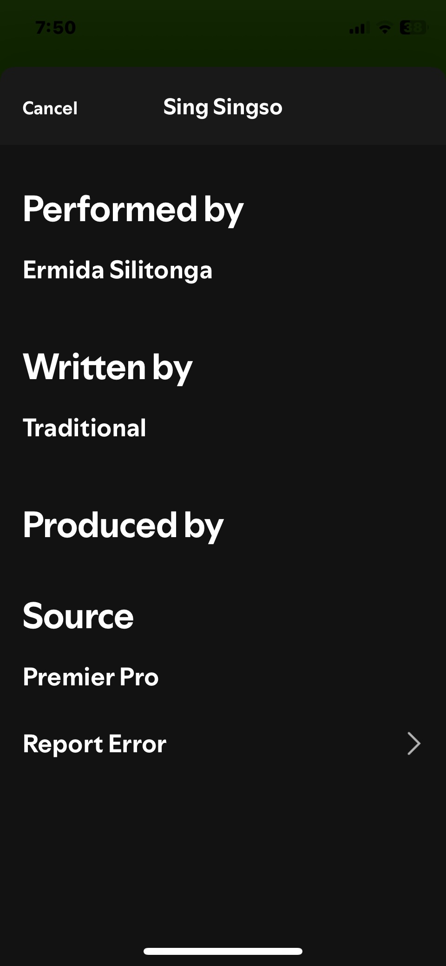
Still Happening? Found in Sep 2025 – “Traditional”?

Slide 14
Trio Ambisi & Bravo Musik Entertainment - Found Feb 2021

Slide 15
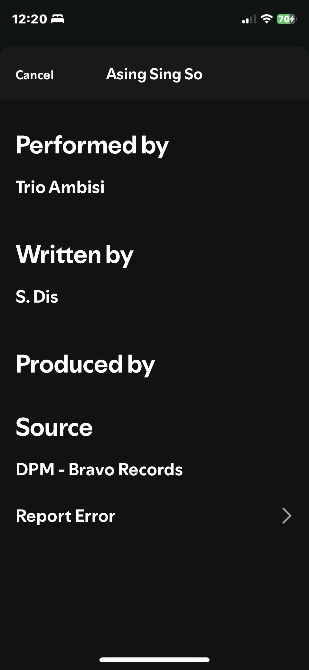
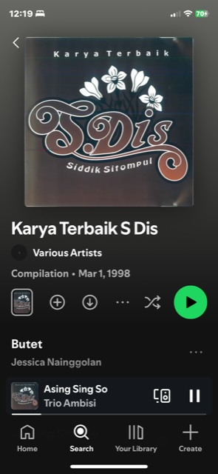
Trio Ambisi & Bravo Music (1998 Compilation) – Correct Information Found in Sep 2025 (S.Dis)

Slide 16
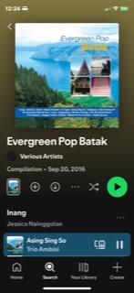
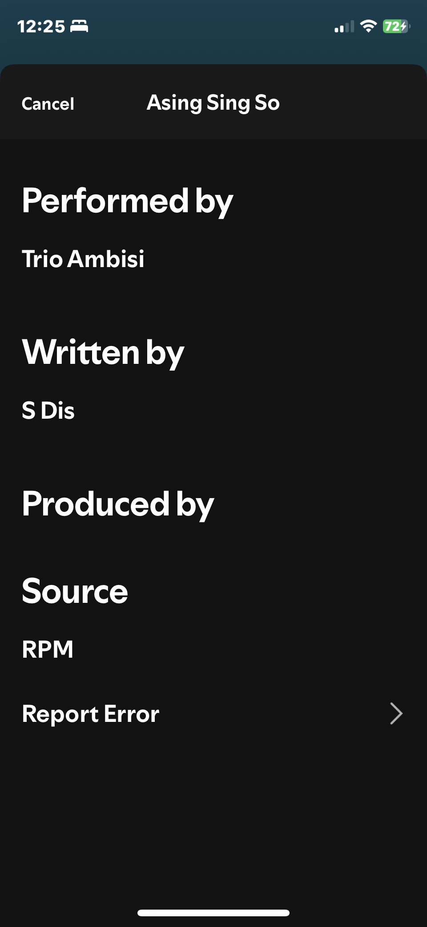
Trio Ambisi & RPM (2016 Compilation) – Correct Information Found in Sep 2025 (S.Dis)

Slide 17
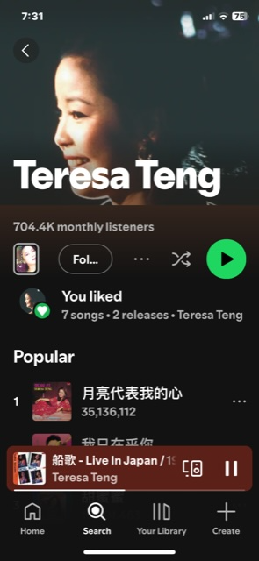
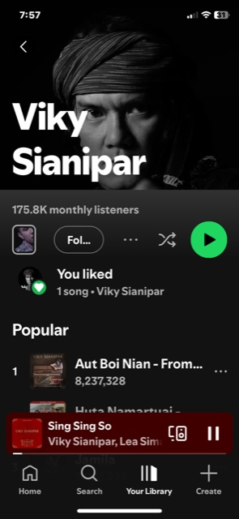
Continuing Damage – Example of Extent: Teresa Teng (704.4k listeners per month) and Viky Sianipar (175.8k per month)

Slide 18
Solution for Continuing Damage – Who?
Who Should be Responsible?
Record Companies?
1. Original Sin – Ethics and Fault
2. Ability/Where Problem lies? (Not just looking at Culprit)
Administratively the Easiest Point (Where the data is)(Technology)
Economics - 80/20 Split

Slide 19
Solution – Legislative Intervention
SOME PROPOSALS:
Statutory duties to maintain and refresh underlying work data when granting or renewing licenses to DSPs and CMOs.
Certification obligations tied to catalogue deliveries. Failures to meet them create a cause of action independent of limitation periods governing tort.
Safe harbour for documented diligent searches by record companies (including “Copyright Control” escrows) to avoid over‑deterrence.
REVERSIONARY INTEREST - Explicit recognition of local‑lyrics authorship in cover versions, with presumptive split norms unless they are proven to be translations. Reversionary interests should be introduced during their lifetime to recognise their contribution.

Slide 20
Reversionary Interests (Mom’s Work)
S5(2), UK Copyright Act 1911 v Article 18, Indonesia’ Copyright Law No. 28 of 2014
Reverts to estate of author v Reverts back to author
25 years after death v 25 years after agreement is made (for “sold flat” agreement)
Outright Assignment - Common
History - music publishing young business in S.E.Asia (UK 1911 Act – tech change)
Cover versions in local lyrics

Slide 21
THANK YOU FOR YOUR ATTENTION!

